Slide 1


The Ship has sailed
The NIST Post-Quantum Crypto “Competition”
Dustin Moody, NIST
Notes:
What is the ship? where did it come from? and where is it going?
What is post-quantum crypto?

Slide 2
Background
The security of crypto relies on intractability of certain problems to modern computers
  Example: RSA and factoring large numbers
Quantum computers
  Exploit quantum mechanics to process information
  Use quantum bits = “qubits” instead of 0’s and 1’s
  Superposition – ability of quantum system to be in multiples states at the same time
  Potential to vastly increase computational power beyond classical computing limit
Notes:
Quantum mechanics = behavior of small objects: atoms, electrons, photons
Superposition – allows for doing multiple computations at same time
“Quantum supremacy”

Slide 3
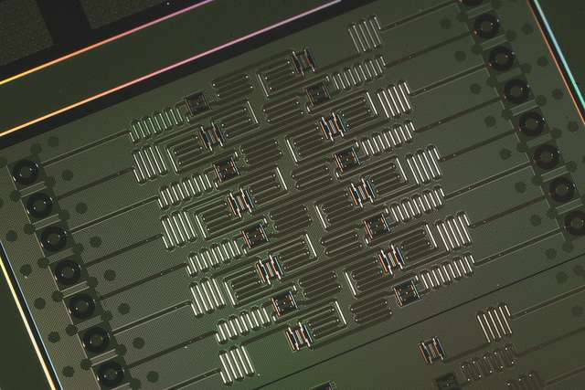
Quantum Computers
Difficulties
  When a measurement is made on quantum system, superposition collapses
  Quantum states are very fragile and must be extremely well isolated
  Intersection of many developing fields: superconductors, nanotechnology, quantum electronics, etc…
1998 – 2 qubits
2000 – 4, 5, and then 7 qubits
2006 – 12 qubits
2011 – 14 qubits
2017 – 17, 49 qubits -> 56?
Measuring qubits is not best metric
IBM’s 5 qubit and 16 qubit processors
Notes:
Entanglement – strong correlation between two quantum particles
Claims of higher qubit computations, but not
IBM making 5-qubit cloud computer available

Slide 4
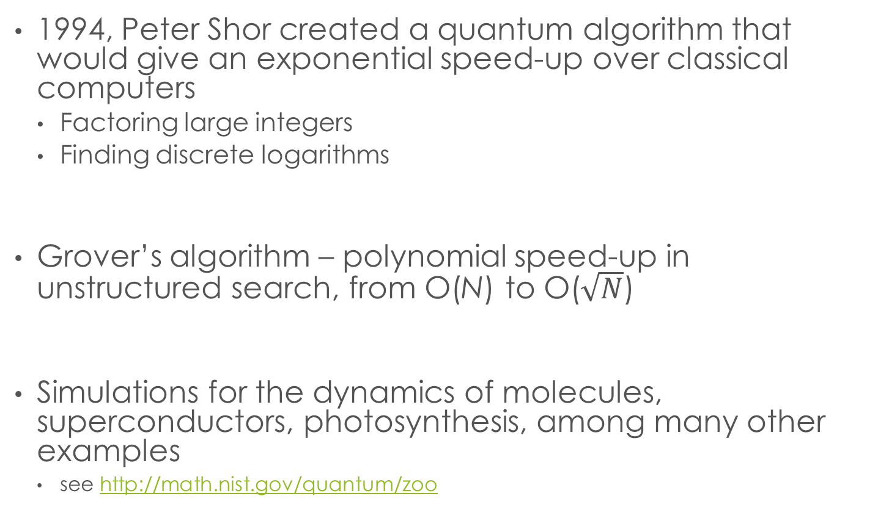
Quantum Algorithms
1994, Peter Shor created a quantum algorithm that would give an exponential speed-up over classical computers
  Factoring large integers
  Finding discrete logarithms
Grover’s algorithm – polynomial speed-up in unstructured search, from O(N) to O($\sqrt{N}$)
Simulations for the dynamics of molecules, superconductors, photosynthesis, among many other examples
  see http://math.nist.gov/quantum/zoo

Slide 5
The impact on crypto
NIST Crypto standards
Public key based
Symmetric key based
Guidelines
Signatures (FIPS 186)
AES (FIPS 197 )
TDEA (800-67)
Modes of operations (800 38A-38G)
Transition (800-131A)
Key establishment (800-56A/B/C)
Key generation (800-133)
SHA-1/2 (FIPS 180) and SHA-3 (FIPS 202)
Key management (800-57)
Tools
Randomized hash (800-106)
RNG (800-90A/B/C)
HMAC (FIPS 198)
KDF (800-108, 800-135)
SHA3 derived functions (parallel hashing, KMAC, etc. (800-185)

Slide 6
The Sky is Falling?
If a large-scale quantum computer could be built then….
NIST Crypto standards
Public key based
Symmetric key based
Guidelines
Signature (FIPS 186)
AES (FIPS 197 )
TDEA (800-67)
Modes of operations (800 38A-38G)
Transition (800-131A)
Key establishment (800-56A/B/C)
Key generation (800-133)
SHA-1/2 (FIPS 180) and SHA-3 (FIPS 202)
Tools
Key management (800-57)
Randomized hash (800-106)
RNG (800-90A/B/C)
HMAC (FIPS 198)
KDF (800-108, 800-135)
SHA3 derived functions (parallel hashing, KMAC, etc. (800-185)

Slide 7
The Sky is Falling?
If a large-scale quantum computer could be built then….
NIST Crypto standards
Public key based
Symmetric key based
Guidelines
Signature (FIPS 186)
AES (FIPS 197 )
TDEA (800-67)
Modes of operations (800 38A-38G)
Transition (800-131A)
Key establishment (800-56A/B/C)
Key generation (800-133)
SHA-1/2 (FIPS 180) and SHA-3 (FIPS 202)
Tools
Key management (800-57)
Randomized hash (800-106)
RNG (800-90A/B/C)
HMAC (FIPS 198)
KDF (800-108, 800-135)
SHA3 derived functions (parallel hashing, KMAC, etc. (800-185)
Notes:
From 1 billion years to 100 seconds for RSA-2048 (assuming a 2-4K QC)

Slide 8

The Sky is Falling?
If a large-scale quantum computer could be built then….
NIST Crypto standards
Post-Quantum Cryptography
Public key based
Symmetric key based
Guidelines
Signature (FIPS 186)
AES (FIPS 197 )
TDEA (800-67)
Modes of operations (800 38A-38G)
Transition (800-131A)
Key establishment (800-56A/B/C)
Key generation (800-133)
SHA-1/2 (FIPS 180) and SHA-3 (FIPS 202)
Tools
Key management (800-57)
Randomized hash (800-106)
RNG (800-90A/B/C)
HMAC (FIPS 198)
KDF (800-108, 800-135)
SHA3 derived functions (parallel hashing, KMAC, etc. (800-185)

Slide 9
Post-Quantum Cryptography (PQC)
Cryptosystems which run on classical computers, and are considered to be resistant to quantum attacks
  Also known as “quantum-safe” or “quantum-resistant”
PQC needs time to be ready
  Efficiency
  Confidence – cryptanalysis
  Standardization
  Usability and interoperability
  (IKE, TLS, etc… use public key crypto)
Notes:
Not quantum crypto

Slide 10

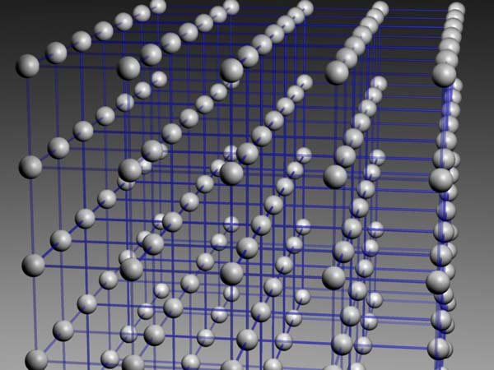
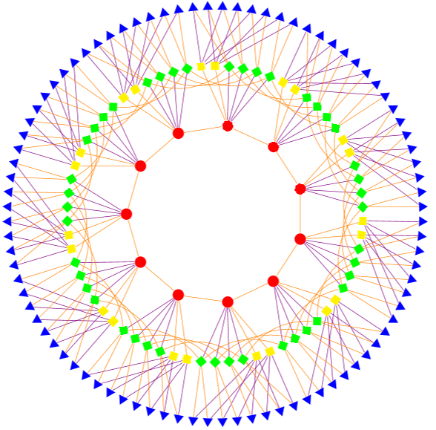
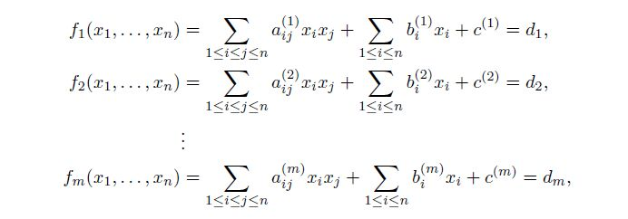
Possible Replacements
Lattice-based
Code-based
Multivariate
Others
  Hash-based signatures
  Isogeny-based
  Etc….
All have their pros and cons

Slide 11
PQC Standardization - too early?
There has been much debate whether it is too early to look into PQC standardization
When will a (large-scale) quantum computer be built?
Notes:
Nobody knows
Similar estimate from Simon Benjamin (Oxford) at ETSI workshop: 15-25 at current spending, but 6-12 years if Manhattan level spending
Brian LaMacchia has said his company is working with a timetable of around 15 years
DJB has private bet ($2048) on twitter that RSA-2048 will be broken by 2033 (16 years)
Industry has been moving towards quantum resistant cryptosystems
Some standards organizations have considered specific schemes (e.g. IETF, hash-based signature) and some
expert groups (e.g. EU PQcrypto) made recommendations
At RSA 2017 – Shamir said PQC doesn’t keep him up at night

Slide 12
PQC Standardization - too early?
There has been much debate whether it is too early to look into PQC standardization
When will a (large-scale) quantum computer be built?
  “There is a 1 in 7 chance that some fundamental public-key crypto will be broken by quantum by 2026, and a 1 in 2 chance of the same by 2031.”
– Dr. Michele Mosca, U. of Waterloo
Our experience tells that we need (at least) several years to develop and deploy PQC standards
Notes:
Nobody knows
Similar estimate from Simon Benjamin (Oxford) at ETSI workshop: 15-25 at current spending, but 6-12 years if Manhattan level spending
Brian LaMacchia has said his company is working with a timetable of around 15 years
DJB has private bet ($2048) on twitter that RSA-2048 will be broken by 2033 (16 years)
Industry has been moving towards quantum resistant cryptosystems
Some standards organizations have considered specific schemes (e.g. IETF, hash-based signature) and some
expert groups (e.g. EU PQcrypto) made recommendations
At RSA 2017 – Shamir said PQC doesn’t keep him up at night

Slide 13
How soon do we need to worry?
How long does your information need to be secure (x years)
How long to re-tool with a quantum safe solution (y years)
How long until a large-scale quantum computer is built (z years)
Theorem (Mosca): If x + y > z, then worry!
What do we do here??
y
x
z
secret keys revealed
time
Notes:
ECC took from it’s invention in 1985 to only now starting to be widely used in 2015. 30 years!
Even if we don’t know when (or even if it will ever happen)….it is a realistic threat so we need to prepare

Slide 14
NSA Announcement
Aug 2015 - NSA's Information Assurance Directorate
updated its list of Suite B cryptographic algorithms
  “IAD will initiate a transition to quantum resistant algorithms in the not too distant future. Based on experience in deploying Suite B, we have determined to start planning and communicating early about the upcoming transition to quantum resistant algorithms.”
Standardization is the first step towards the transition

Slide 15
The decision to move forward
NIST decided it is the time to look into standardization
We see our role as managing a process of achieving community consensus in a transparent and timely manner
We do not expect to “pick a winner”
  Ideally, several algorithms will emerge as ‘good choices’
Notes:
We starting getting ready to launch the ship
(we’d been building it for awhile, see next page)

Slide 16

What we have done so far –
The first mile in a long journey
~ 2012 – NIST begins PQC project
  Research and build NIST team
April 2015 – 1st NIST PQC workshop
Aug 2015 – NSA statement
Feb 2016 – NIST Report on PQC (NISTIR 8105)
Feb 2016 – NIST preliminary announcement of standardization plan
Aug 2016 – Draft submission requirements and evaluation criteria released for public comments
Sep 2016 – Comment period ended
Dec 2016 – Finalized requirements and criteria (Federal Register Notice)
Nov 2017 – Deadline for submissions
Notes:
Or you could say “building the ship”

Slide 17

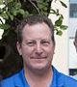
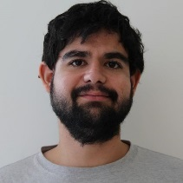
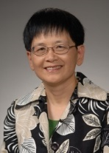
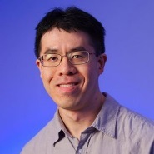


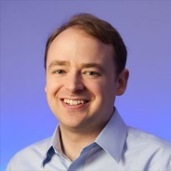
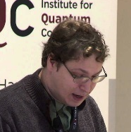

The NIST PQC team
Consists of 12+ NIST researchers in crypto, quantum information, quantum algorithms
Hold bi-weekly seminars (internal and invited speakers)
Publish results in journals/conferences
Engage with research community
Work with industry and standards organizations (ETSI, IETF, ISO/IEC SC27)
Reach government agencies for raising awareness of upcoming cryptography transition
Collaborate with QuiCS at the Univ. of Maryland, as well as Univ. of Waterloo
Notes:
Still want to expand

Slide 18
NIST’s PQC contest Standardization Plan
Timeline
Nov. 30, 2017 | Submission deadline
April 2018 | Workshop – Submitters’ presentations
3-5 years | Analysis phase - NIST reports on findings and more workshops/conferences
2 years later | Draft standards available for public comments
NIST will post “complete and proper” submissions - Dec 2017
NIST PQC Standardization Conference (with PQCrypto, Apr 2018)
Initial phase of evaluation (12-18 months)
  Internal and public review
  No modifications allowed
Narrowed pool will undergo a second round (12-18 months)
  Second conference to be held
  Minor changes allowed
Possible third round of evaluation, if needed
NIST will release reports on progress and selection rationale
Notes:
Subject to change
We want community’s help as well

Slide 19
Scope
Signatures
  Public-key signature schemes for generating and verifying digital signatures (FIPS 186-4)
Encryption
    Key transport from one party to another
    Exchanging encrypted secret values between two parties to establish shared secret value (see SP 800-56B)
Key-establishment (KEMs)
    Schemes like Diffie-Hellman key exchange (see SP 800-56A)
Notes:
The scope is determined by the NIST current standards.

Slide 20
Differences with AES/SHA-3 competitions
Post-quantum cryptography is more complicated than AES or SHA-3
  No silver bullet - each candidate has some disadvantage
  Not enough research on quantum algorithms to ensure confidence for some schemes
We do not expect to “pick a winner”
  Ideally, several algorithms will emerge as “good choices”
We will narrow our focus at some point
  This does not mean algorithms are “out”
Requirements/timeline could potentially change based on developments in the field
Notes:
We will devote substantial amount of resources, but will be less than for SHA-3

Slide 21

Minimal acceptability requirements
  Publicly disclosed and freely available during the process
    Signed statements, disclose patent info
  Implementable in wide range of platforms
  Provides at least one of: signature, encryption, or key establishment
  Theoretical and empirical evidence providing justification for security claims
  Concrete values for parameters meeting target security levels

Slide 22
The selection criteria
Security - against both classical and quantum attacks
Performance - measured on various "classical" platforms
Other properties
  Drop-in replacements - Compatibility with existing protocols and networks
  Perfect forward secrecy
  Resistance to side-channel attacks
  Simplicity and flexibility
  Misuse resistance, and
  More
Notes:
Are all the important other properties covered?

Slide 23
Summary of Comments Received
26 comments submitted
  Clarifications in the text of the Call For Proposals
  Require constant-time implementations?
  More implementation platforms
  Intellectual Property requirements
  Decryption failure threshold
  Public-key encryption and key-exchange issues (KEMs)
  Quantum security and target security levels
  API suggestions
Notes:
From short to long. From around the world
Clarifications: perfect forward secrecy, post-quantum crypto. Change the wording here. Insert this text.
KEMs and public-key encryption can generally be converted back and forth
Still requiring IND-CCA2 security
As a result of comments, we are adding another option:
Purely ephemeral key-exchange protocol can be done so that only passive security is required
NIST will consider encryption or KEM scheme which provides semantic security with respect to chosen plaintext attack (IND-CPA security)
Diffie-Hellman type schemes can be submitted as KEMs
Authenticated key-exchange is out of scope, as it is a protocol, not a primitive

Slide 24
Complexities of PQC Standardization
Much broader scope – three crypto primitives
  Signatures, Encryption, Key agreement
Both classical and quantum attacks
  Security strength assessment on specific parameter selections
Consider various theoretical security models and practical attacks
  Provably security vs. security against instantiation or implementation related security flaws and pitfalls
Multiple tradeoff factors
  Security, performance, key size, signature size, side-channel resistance countermeasures
Migrations into new and existing applications
  TLS, IKE, code signing, PKI infrastructure, and much more
Not exactly a competition – it is and it isn’t
Notes:
I like to highlight some complexities for PQC standardization. First, large scope, three crypto primitives, not like AES and SHA-3 competition. Second we need to consider both classical security and quantum security. I will further discuss quantum security late on in this presentations. Now we have established security models to prove the security, we also have many applications where the practical attacks can happen regardless the proof results. For each of the primitive, we have multiple tradeoff factors. For example, for hash based signature, stateful signature is shorter and stateless signature is larger. PQC is different from the first generation of PKC. At that time, we were trying to plug in and trying to make it work. Now we reply on those, replace them with new one will certainly not an easy task. We will talk challenges in a separate page. People ask us whether this is a competition, we have bene reluctant to call it a competition. Yes and No. Yes- Open and trans, public proposal and public analysis, NIST will make selection based on the synopsis. No – Not one algorithm, three primitives each may have more than one, no straight forward comparison, selection will be made in multiple rounds

Slide 25
Security Analysis
Security definitions
  IND-CPA/IND-CCA2 for encryption, KEMS and EUF-CMA for signatures
  Used to judge whether an attack is relevant
Quantum/classical algorithm complexity
  Classical computers are not going away, and may have the cheapest attacks in practice
  Stability of best known attack complexity
  Precise security claim against quantum computation
  Parallelism?
Security proofs (not required but considered as support material)
Quality and quantity of prior cryptanalysis
Notes:
We may ask for a wider range of security levels than we ultimately decide to standardize
Indistinguishability under adaptive chosen ciphertext attack
EUF-CMA: Existential unforgeability under adaptive chosen message attacks
Grover’s algorithm doesn’t parallelize well
Science for assessing classical security is better developed than that for assessing quantum security
Classical cryptanalysis can improve our understanding of the structure underlying the primitive, which is also the basis for quantum cryptanalysis

Slide 26
Quantum Security – How to assess it?
  No clear consensus on best way to measure quantum attacks
  Uncertainties
    The possibility that new quantum algorithms will be discovered, leading to new attacks
    The performance characteristics of future quantum computers, such as their cost, speed and memory size
  Currently, NIST crypto standards specify parameters for classical security levels at 112, 128, 192, 256 bits
  For PQC standardization, need to specify concrete parameters with security estimates

Slide 27
Quantum Security Strength Categories
 | Security Description
I | At least as hard to break as AES128 (exhaustive key search)
II | At least as hard to break as SHA256 (collision search)
III | At least as hard to break as AES192 (exhaustive key search)
IV | At least as hard to break as SHA384 (collision search)
V | At least as hard to break as AES256 (exhaustive key search)
Computational resources should be measured using a variety of metrics
  Number of classical elementary operations, quantum circuit size, etc…
  Consider realistic limitations on circuit depth (e.g. 2⁴⁰ to 2⁸⁰ logical gates)
  May also consider expected relative cost of quantum and classical gates.
These are understood to be preliminary estimates
  Submitters need not provide parameters for all levels
Notes:
Want submitters to primarily focus on levels 1,2,and 3
Also at least one parameter set for very high security (4 or 5)
Assume a PQC algorithm has only one tunable parameter, corresponding to classical security
Assume no quantum attacks, beside generic ones (i.e. Grover-based ones)
To meet security strengths 1, 3, 5 set classical security to 128, 192, 256 bits respectively
Security strength 2 means somewhere between 128 and 192 bits of classical security. Where exactly depends on how well the classical attacks “Groverize”
i.e., how effective are generic techniques for decreasing the cost of the classical attacks using quantum computer
Security strengths 2 and 4 are defined in such a way that they offer the maximum possible quantum security strength that can be offered by a scheme that only has a classical security strength of 128 or 192 bits, respectively
If they Groverize well, you will need a classical security strength on the high end of the range, and if they Groverize poorly, you will need a classical security strength on the low end of the range.

Slide 28
Cost and Performance
Standardized post-quantum cryptography will be implemented in “classical” platforms
Ideally, implementable on wide variety of platforms and applications
May need to standardize more than one algorithm for each function to accommodate different application environments
from extremely processing constrained devices to limited communication bandwidth
Allowing parallel implementation for improving efficiency is certainly a plus
Preliminary conclusions: efficiency likely OK, but key sizes may pose a significant challenge

Slide 29
The pqc stack
Applications | Web browsers, certificates, Tor, Signal, software updates, secure boot, etc.
Protocols | SSL, TLS, IPSec (IKE)
Cryptography | Post-Quantum: Encryption Signatures Key exchange Hybrid Modes (PQC+classical)
Lower level | Libraries (GMP, NTL, etc.) Block ciphers (AES) Hash functions (SHA-2/3) RNGs Hardware support for maintain state for hash-based signatures

Slide 30
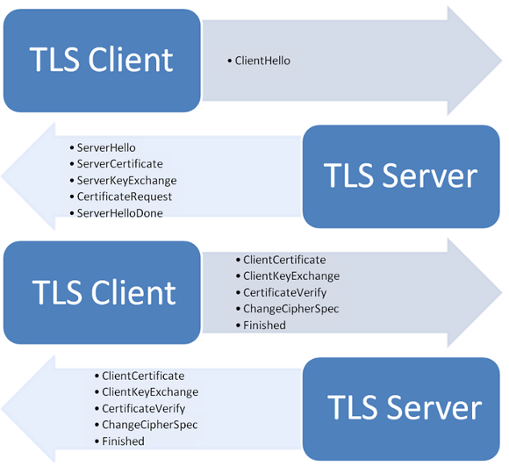
Drop-in Replacements
We’re looking for drop-in replacements for existing applications, e.g. IKE and TLS
  Key establishment
    Ideally, we’d like to have something to replace Diffie-Hellman key exchange
    Practically, we have to look into some schemes such as encryption with one-time public key, which are not quite drop-in replacements
  Signatures
    We’d like to have signatures with reasonable public key size, signature size, and fast signature verification
    Practically, we shall prepare to handle probably larger public keys, or/and larger signatures, (and to handle a stateful situation)
We need to be realistic about what we can get

Slide 31

Challenges
Uncertainties – Quantum Security
Assess classical security
  Most of PQC schemes are relatively new
  It’ll take years to understand their classical security
We need to deal with new situations which we haven’t considered before, e.g.
  Decryption failure
  State management for hash based signatures
  Public-key encryption vs. key-exchange issues
    Public-key encryption IND-CCA2
    Ephemeral key exchange (no key-pair reuse, consider passive attacks, IND-CPA)
  Auxiliary functions/algorithms, e.g.
    Gaussian simulation
We have to move away from many things we have been used with existing schemes
Notes:
Quantum security is just one of the challenges. We need to handle many situations which are new to us. Here are just a few examples. The first is decryption failure. Some encryption algorithms, even you choose everything right, can have failed decryption. It may require a higher level protocol to handle how many decryption failures are allowed before halt. Some hash based signature needs to manage state. Each private key can only use once. The chosen ciphertext model does not apply to one-time key for key establishment. As we work hard on Random number generator for uniformly at random key generation, for some of the post-quantum schemes, we will be Gaussian simulation to generate one time random value.

Slide 32
Preliminary submissions
Submitters who sent us their algorithms by Sept. 30th were able to have their submissions checked for “completeness”
37 submissions received
  10 signature schemes
  27 Encryption/KEM schemes
  15 were lattice-based
  7 were code-based
  5 were multivariate
  The rest were a mix (hash-based, isogenies, ….)
From 15 states, 18 countries, and 5 continents
Notes:
Everyone wondering how many submissions …..
7 were complete
Most had minor issues, many dealing with implementation

Slide 33

final submissions received
The deadline is past – no more submissions
82 total submissions received
  23 signature schemes
  59 Encryption/KEM schemes
Notes:
The Ship has Sailed!
To be posted as soon as possible
46 submissions (including resubmissions) on final day.

Slide 34
A further breakdown
 | Signatures | KEM/Encryption | Overall
Lattice-based | 4 | 24 | 28
Code-based | 5 | 19 | 24
Multi-variate | 7 | 6 | 13
Hash-based | 4 |  | 4
Other | 3 | 10 | 13
Total | 23 | 59 | 82

Slide 35
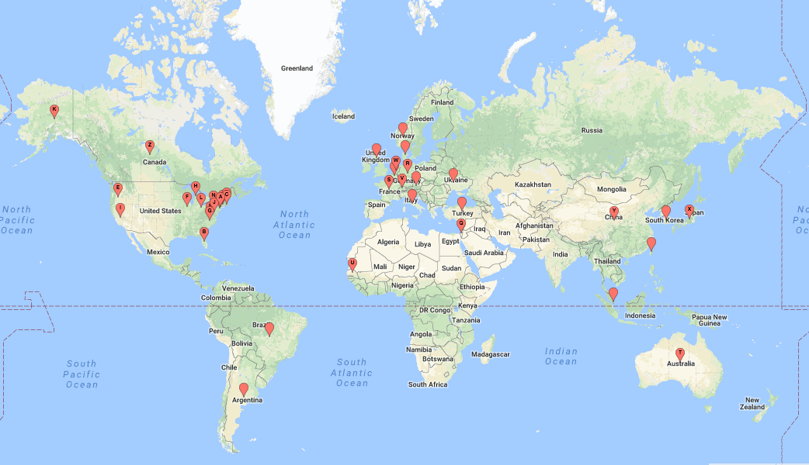
From 16 states, 25 countries, and 6 continents
Notes:
(use geobatch to create map of submissions?)

Slide 36
Transition and Migration
NIST will update guidance when PQC standards are available
    SP 800-57 specifies classical security levels 128, 192, and 256 bits are acceptable through 2030
Even with the upcoming PQC transition, anything with classical security less than 112 bits should NOT be used anymore
  A “hybrid mode” has been proposed as a transition/migration step towards PQC
Such a mode combines a classical algorithm with a post-quantum one
Current FIPS 140 validation will only validate the NIST-approved (classical) component
The PQC standardization will only consider the post-quantum component
Notes:
SKIP

Slide 37
Interactions with Standards Organizations
We are aware that many standards organizations and expert groups are working on PQC
  IEEE P1363.3 has standardized some lattice-based schemes
  IETF is taking action in specifying stateful hash-based signatures
  ETSI has released quantum-safe cryptography reports
  EU expert groups PQCrypto and SafeCrypto made recommendations and released reports
  ISO/IEC JTC 1 SC27 has already had three 4-6 month study periods for quantum-resistant cryptography
NIST is interacting and collaborating with these organizations and groups
NIST plans to consider hash-based signatures as an early candidates for standardization, but probably just for specific applications like code signing

Slide 38
Discussions and Questions
Since the draft call for proposals was announced, the NIST team has actively interacted with submitters and researchers
The questions include
  APIs to support different ancillary functions
  Using third party libraries
  Submission format
  etc.
The topics discussed at pqc-forum@list.nist.gov include
  Quantum vs. classical security strength
  Security notions (IND-CCA2, IND-CPA, etc.)
  Random number generator
  Key exchange vs. key encapsulation
  Implementation details, etc…..
Answers to the common questions and summaries on the major discussion topics were added to the FAQ at www.nist.gov/pqcrypto

Slide 39
What to expect next?
NIST will post “complete and proper” submissions for analysis at www.nist.gov/pqcrypto as soon as possible
The 1st NIST PQC Standardization Conference (co-located with PQCrypto, April 2018)
  For submitters to present their algorithms and design rationale
  For researchers and practitioners to ask questions on the submitted algorithms
Evaluation and analysis continue (16~18 months)
The 2nd NIST PQC Standardization Conference will likely be Aug/Sept 2019
Analysis and evaluation
More analysis …
Publish submissions
2nd Conference
………
Draft standards
Submission due
1st conference
………
Nov. 30, 2017
Dec. 2017
April, 2018
Aug.(?) 2019

Slide 40
Summary
Quantum computers have HUGE potential
Post-quantum cryptography standardization is going to be a long journey
We have already observed many complexities and challenges, with more to come.
Be prepared to transition to new algorithms in 10 years
We will continue to work with the community towards PQC standardization
See www.nist.gov/pqcrypto
Sign up for the pqc-forum for announcements and discussion
Notes:
Transition will not be painless

